Slide 1
EZJoin - Connect Cloud-based solution
  For ZOOM and Bluejeans

Slide 2
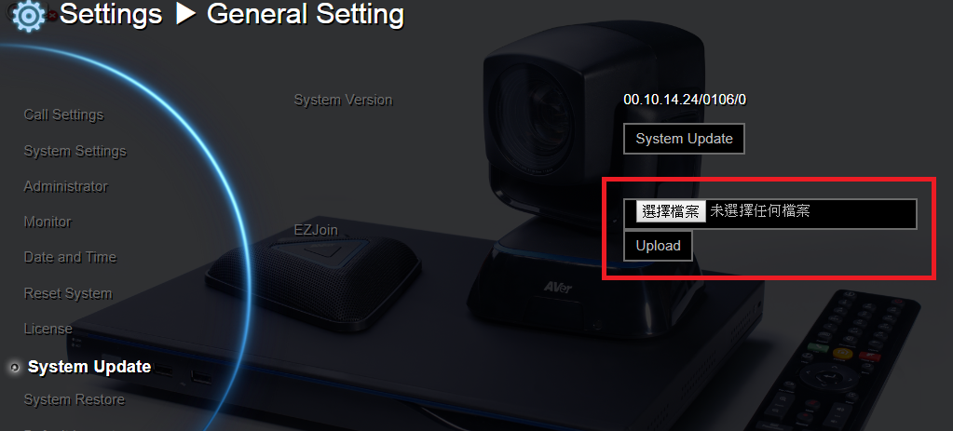
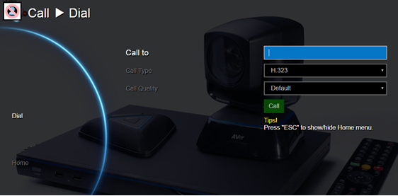
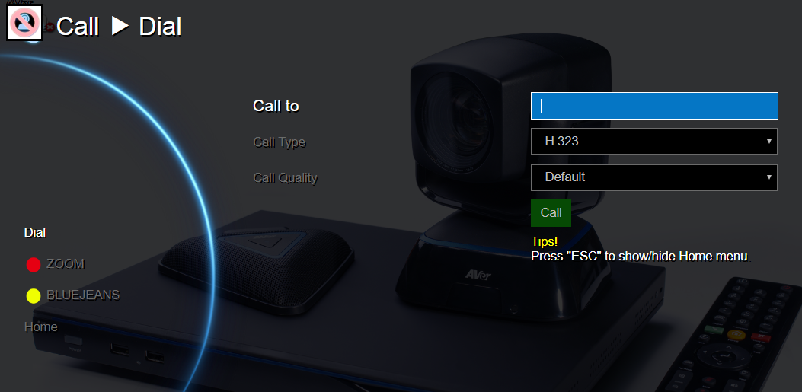
EZJoin 1 2 3
Download the XML file from AVer website download center
http://communication.aver.com/DownloadFile.aspx?n=4479|1F68B2E9-7B97-4F10-9BC7-553940119426&t=ServiceDownload

Slide 3
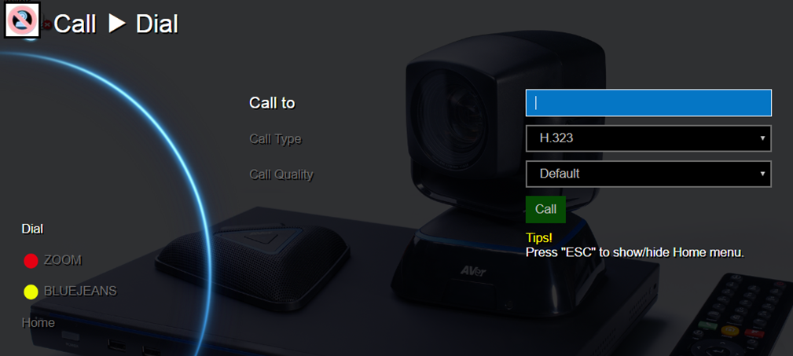
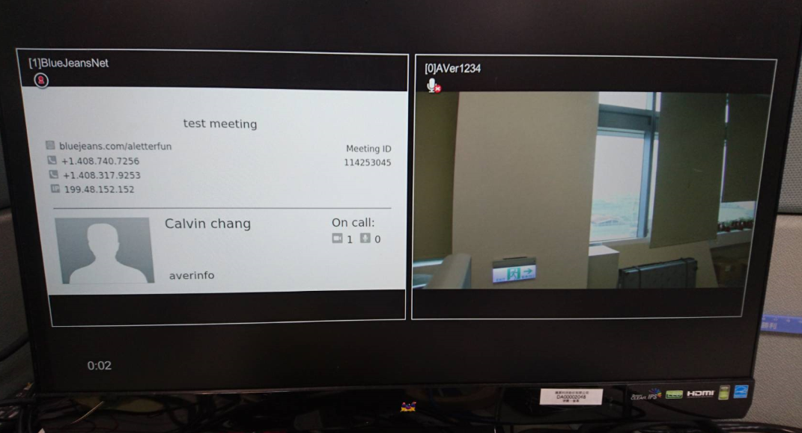
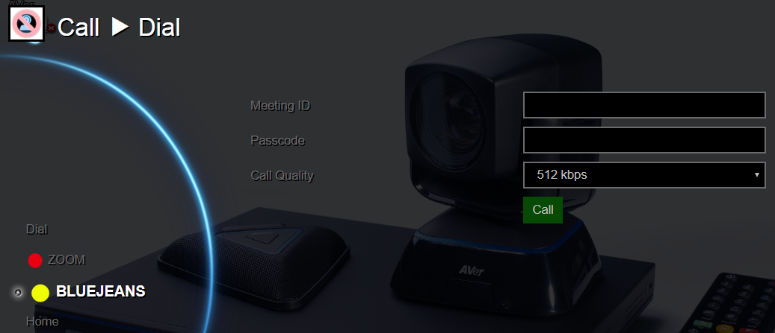
EZJoin 1 2 3
2. Press the remote controller color button to enter 3rd party Cloud of ZOOM or BLUEJEANS ..
3. Fill in the Meeting ID and passcode => Call, go to 3rd VMR Meeting.. Demo video:

